Slide 1
Notebooks, PowerShell and Excel Automation
Rob Sewell
He/Him,
Beard Twizzler,
Sewells Consulting Ltd

Slide 2
Explore PASS

Slide 4

Rob Sewell
He/Him
Bearded Consultant
Automator
Trainer
Dual MVP
Consultant Sewells Consulting Ltd
dbatoolsMoL dbachecks
ADSNotebooks PowerShell Community
Data Community
beard.media\book
@sqldbawithbeard
blog.robsewell.com

Slide 5
Rob Sewell
He/Him
Bearded Consultant
Automator
Trainer
Dual MVP
Consultant Sewells Consulting Ltd
dbatoolsMoL dbachecks
ADSNotebooks PowerShell Community
Data Community
beard.media\book
@sqldbawithbeard
blog.robsewell.com
Notes:
OBS:SpeakerCircle

Slide 6
Rob Sewell
Bearded Consultant
Automator
Trainer
Dual MVP
Consultant Sewells Consulting Ltd
dbatoolsMoL dbachecks
ADSNotebooks PowerShell Community
Data Community
beard.media\book
@sqldbawithbeard
blog.robsewell.com
Notes:
OBS:SpeakerCircleandSide

Slide 7
We don’t have enough #VirtualPASSSelfies
Notes:
OBS:SpeakerFullUp

Slide 8
Pop Quiz
In organisations Where is most data used ?
Notes:
OBS:Full Screen

Slide 9
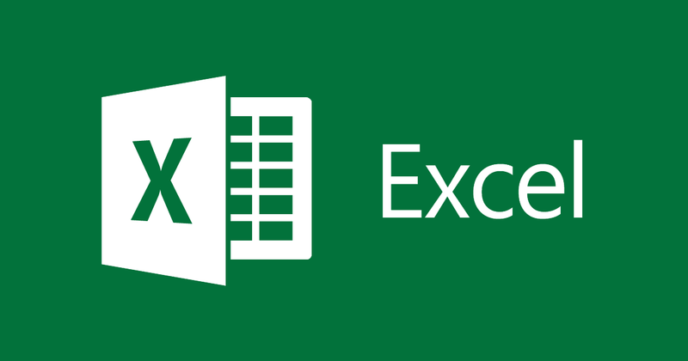
Notes:
OBS:Full Screen

Slide 10
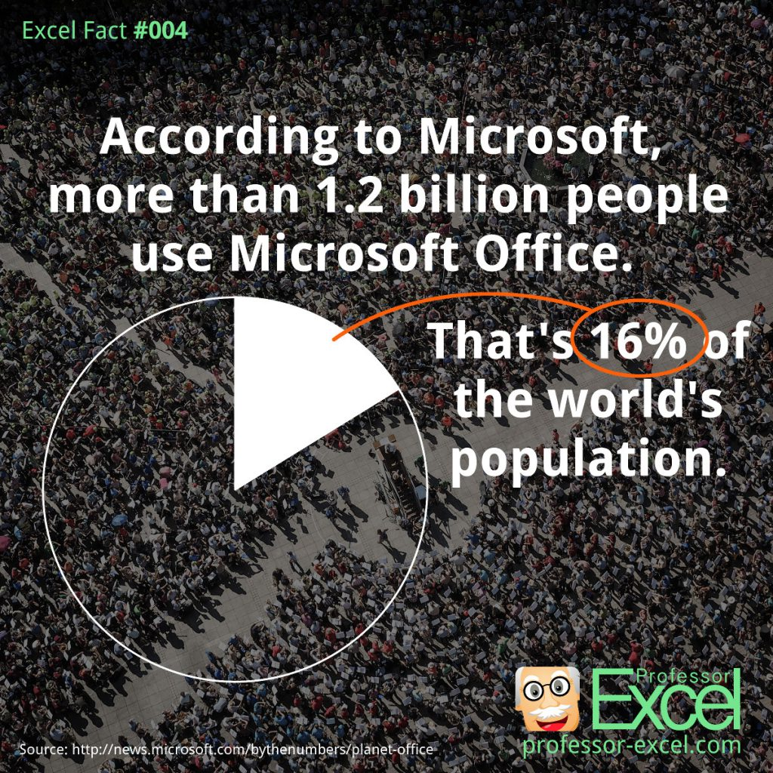
Notes:
OBS:SpeakerRightFull

Slide 11
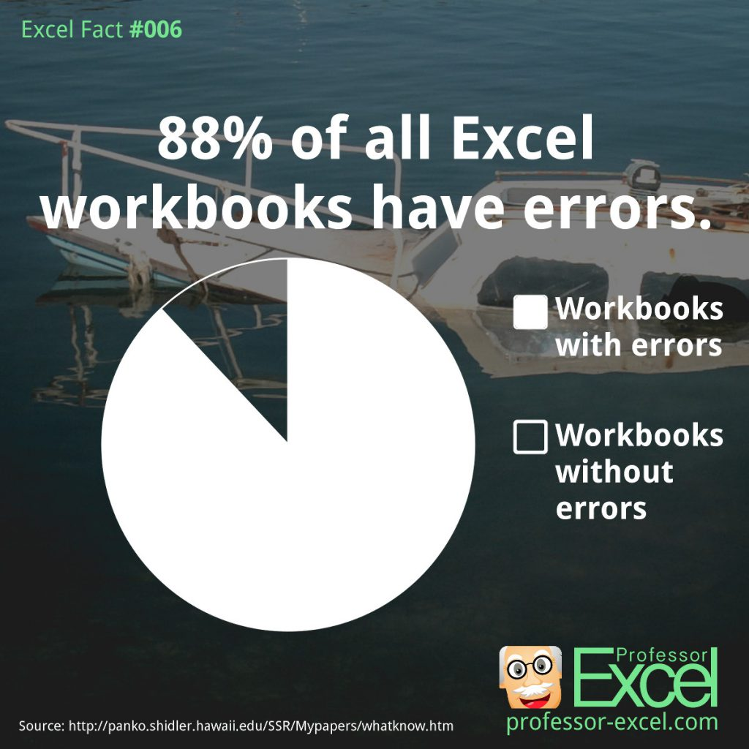
Notes:
OBS:SpeakerRightFull

Slide 12

Notes:
OBS:Full Screen

Slide 13

So – What IS a Jupyter Notebook?
Originally for Data Scientists
Notes:
OBS:SpeakerTinySquare

Slide 14

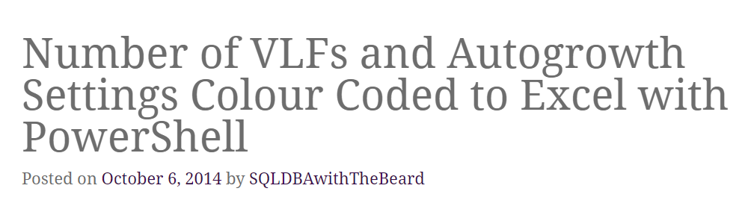

Slide 15
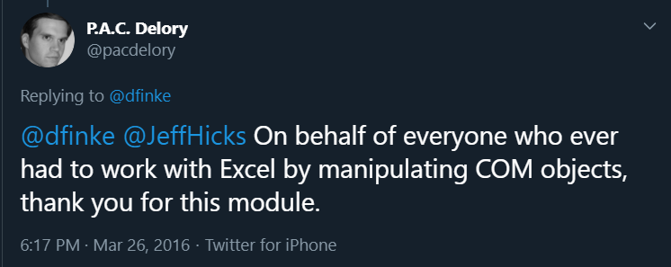

Slide 16
What is a Jupyter Notebook?
Document that can contain text, code, images and query results
Notes:
OBS:SpeakerCentreBottom

Slide 17
What is a Jupyter Notebook?
Document that can contain text, code, images and query results
Notes:
OBS:SpeakerCentreBottom

Slide 18

Time For A DEMO

Slide 19
Rob Sewell He/Him
@SqlDbaWithBeard
blog.robsewell.com

